Slide 1
LICENSE PLATE RECOGNITION

Slide 2
Introduction
License Plate Recognition also known as LPR is a technology where characters from video footage are automatically recognized and recorded for security & traffic analysis purpose. Involves low-level image Processing techniques with higher level of Artificial Intelligence techniques.

Slide 3
Key Feature
Accurate Reports
Real time Monitoring
Identify Lists of Registration numbers

Slide 4
Problem Statement
Create an affordable solution through image processing of number plates of vehicles for the detection, identification and monitoring of vehicles in different scenarios such as residential societies, tolls business complex, parking spaces etc.

Slide 5
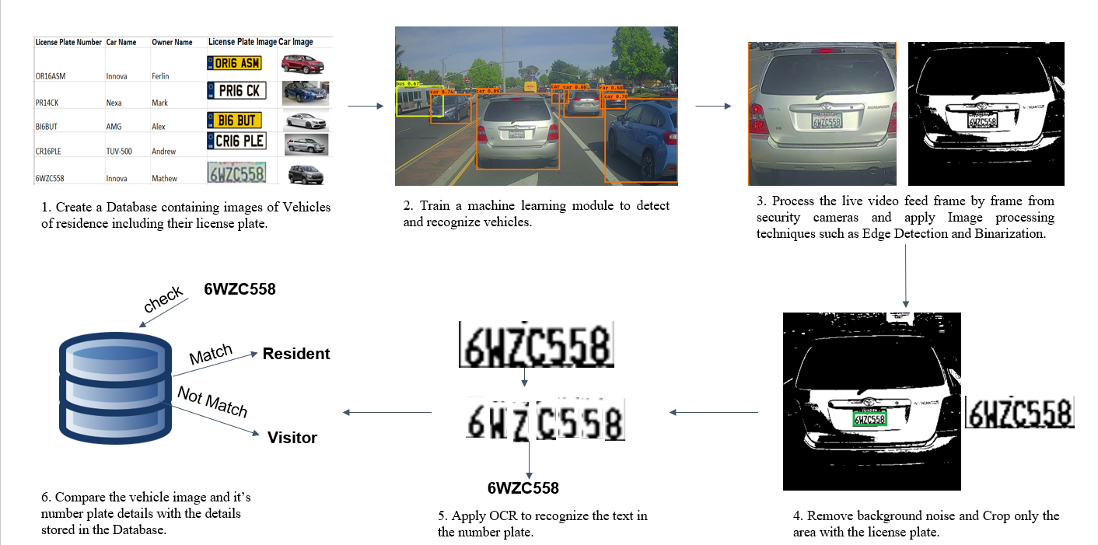
Solution
1. Create a Database containing images of vehicles of residence including their license plate number.

Slide 6
2. Train a machine learning module to detect and recognize vehicles.

Slide 7
3. Process the live video feed frame by frame from security cameras and apply image processing techniques such as Edge Detection and Binarization.

Slide 8
4. Remove background noise and crop only the area with the license plate.

Slide 9
5. Apply Optical Character Recognition to recognize the text in the number plate.

Slide 10
Compare the Vehicles image and its number plate details with the details stored in the database.

Slide 11
Applications
Security Monitoring of roads and checkpoints.
Traffic Analysis
State border control
Vehicle theft prevention and Surveillance
Highway toll Collection.
Police law enforcement

